Slide 1

ONLINE
RAILWAY
RESERVATION
SYSTEM(ORRS)

Slide 2


INTRODUCTION
The Online Railway Reservation
System using Database Management
System (DBMS) is a sophisticated platform
designed to streamline and automate the process
of booking train tickets. Leveraging the power of a well-
structured database, this system ensures efficient storage and
retrieval of passenger information, train schedules, and seat availa
-bility. By integrating DBMS, the system enhances data integrity, reduces
redundancy, and facilitates seamless transactions. This user-friendly platform
aims to provide a reliable and convenient solution for passengers to book, modi-
-fy, and cancel train reservations, thereby optimizing the overall railway ticketing
process.

Slide 3

SCHEMA DIAGRAM
Admin
Admin_id
Admin_username
Admin_pwd
Admin_email
Admin_lname
Admin_fname
Employee
Emp_id
Emp_email
Emp_fname
Emp_lname
Emp_pwd
Emp_dep
Passenger
Pass_id
Pass_email
Pass_Train_name
Pass_pwd
Pass_train_no
Pass_name
Password resets
Pwd_id
Pwd_email
Pwd_status
Trains
Train_id
Train_name
Train_no
Train_fare
Train-Tickets
Train_id
pass_name
TrainTicket_fare
TrainTicket_name
TrainTicket_no

Slide 4
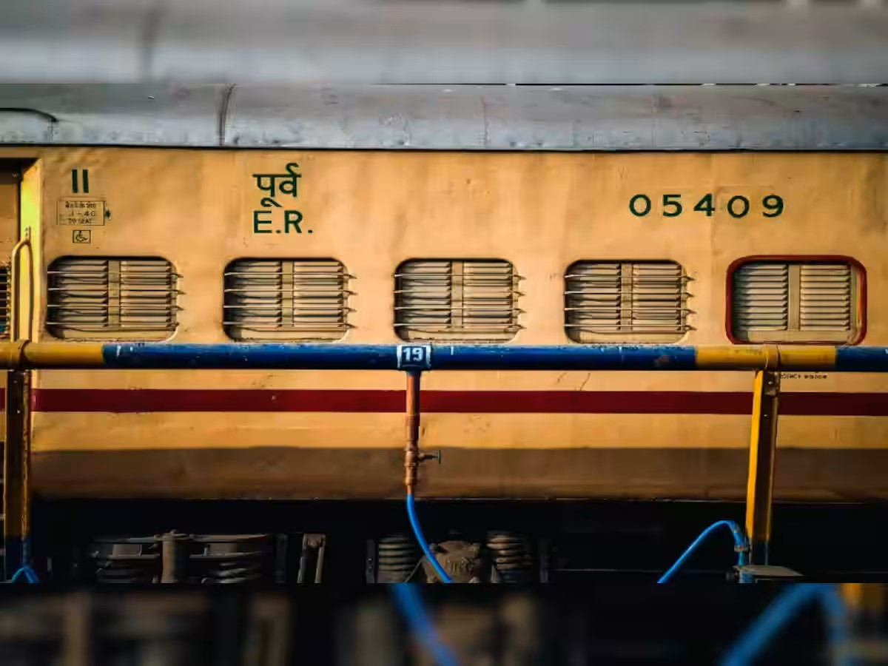
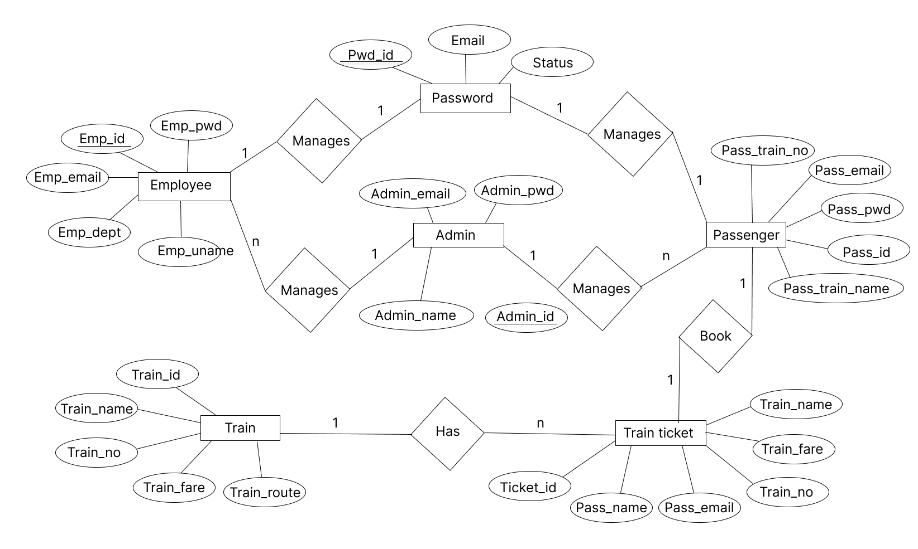
ER DIAGRAM

Slide 5
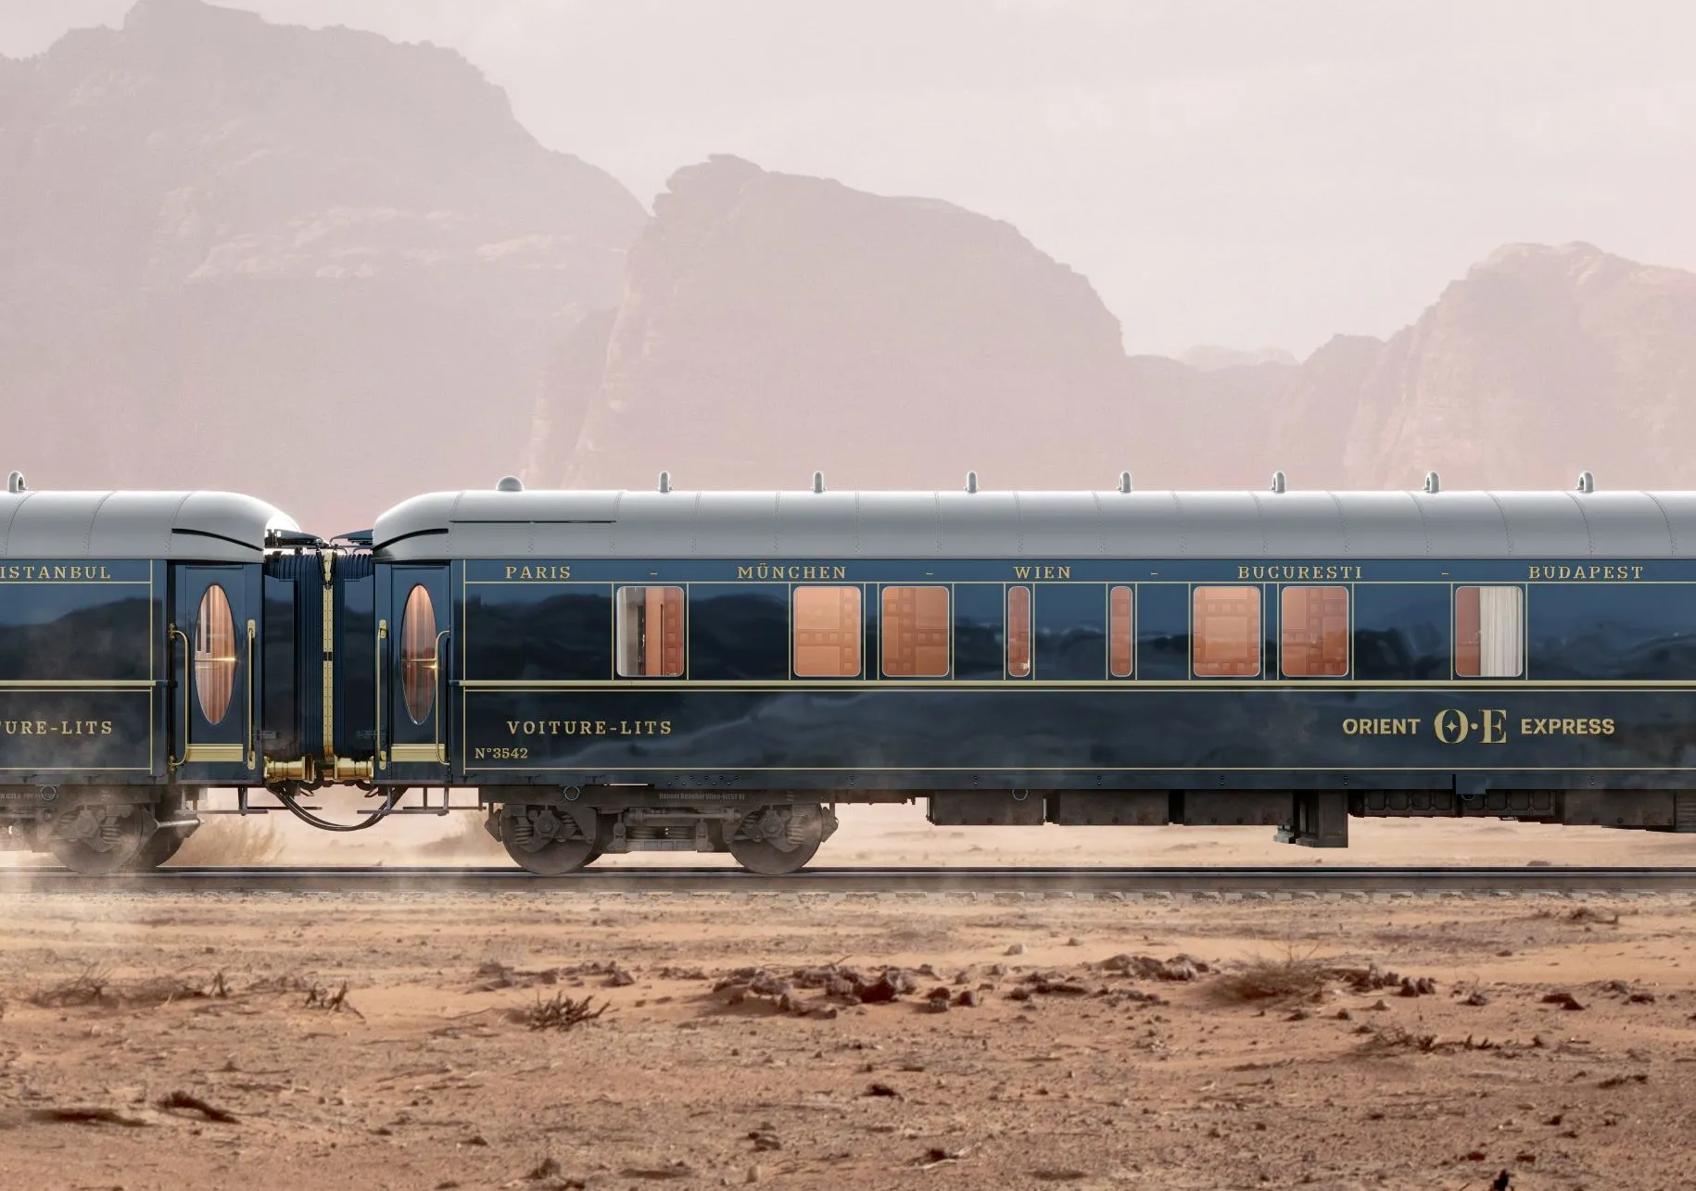
The methodology for making this project
clearly defines the functionalities required in
the system,considering aspects like ticket booking
,train schedules,passenger information,and
administrative features.It also identify the entities
(e.g., trains, stations,users), their attributes, and relationships.It creates a normalized database schema to ensure data integrity.Implement the designed database
schema in MySQL by creating tables for each entity with appropriate datatypes and constraints.
Inserting the sample data into the tables to simulate a
realistic environment for testing and development.It develops SQL queries for common operations such as retrieving train schedules, booking tickets, updating passenger details,and generating reports uses MySQL stored procedures for complex queries and triggers
to automate certain actions, enhancing system
efficiency.
METHODOLOGY

Slide 6
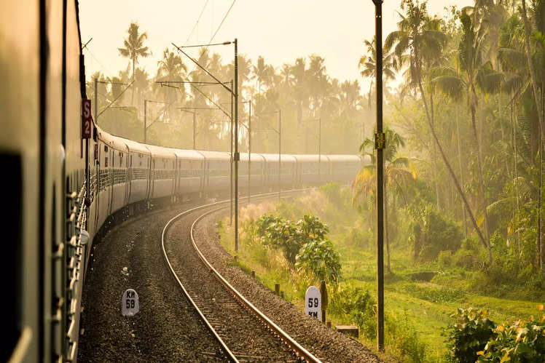
• Implement a secure login
system with user roles to control access
to different functionalities. It builds a user-
friendly interface for interacting with the
system, incorporating forms for data input and
views to display information. Implement the
backend logic to handle user requests, process data,
and interact with the database using a programming
language (e.g., Python,Java) and a web framework if
applicable. Conduct thorough testing of the system to
identify and fix any bugs or issues.Verify that the system meets
the specified requirements.

Slide 7
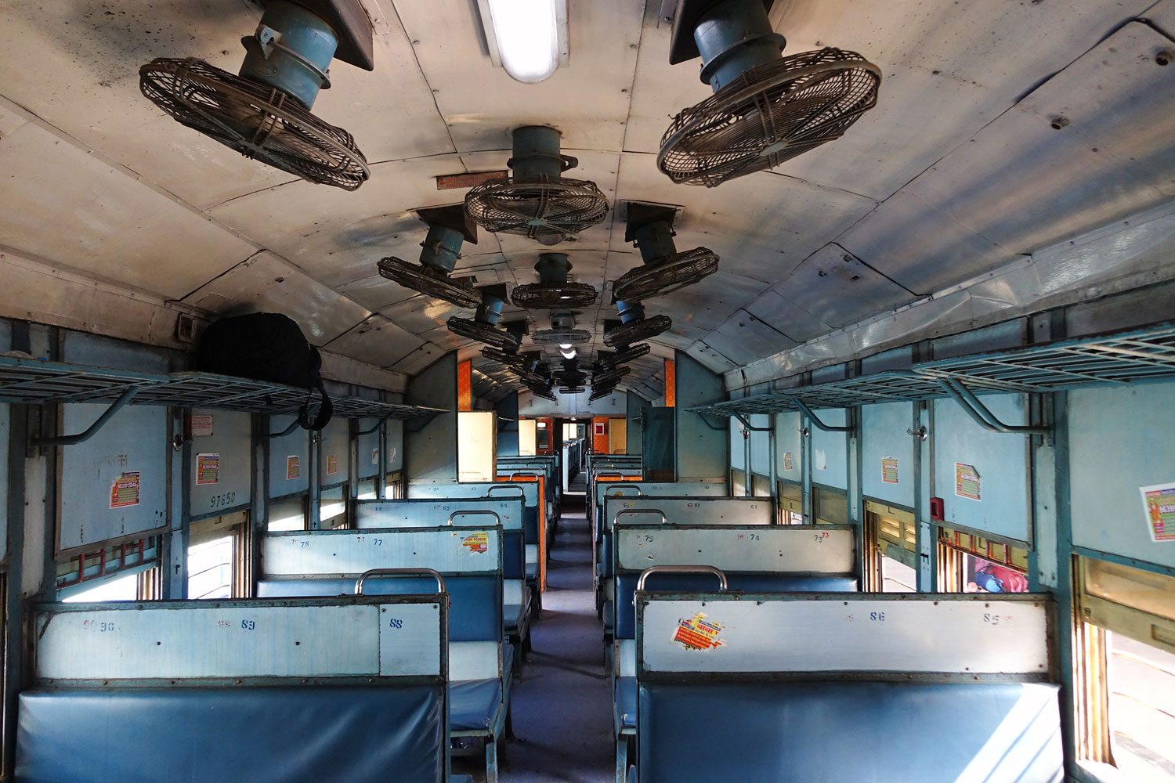
OUTCOME
The results of the railway station management system database project can be evaluated in terms of the system's performance, usability, and impact on railway station operations. Here are some possible results that can be expected from the project:
1. Improved Efficiency: Streamlined train operations, optimized resource allocation, and reduced delays contribute to overall efficiency in railway management.

Slide 8
OUTCOME
The outcome of an online railway reservation system project using HTML, PHP, and DBMS would typically be a web-based application that allows users to browse train schedules, book tickets, and manage reservations.
The project would likely include features such as user authentication, ticket availability checking, and a database to store and retrieve information about trains, passengers, and reservations.
The user interface would be created using HTML, the functionality would be implemented using PHP, and the data would be managed using a Database Management System (DBMS) like MySQL or PostgreSQL. The final result would be a fully functional online platform for railway ticket reservations.

Slide 9
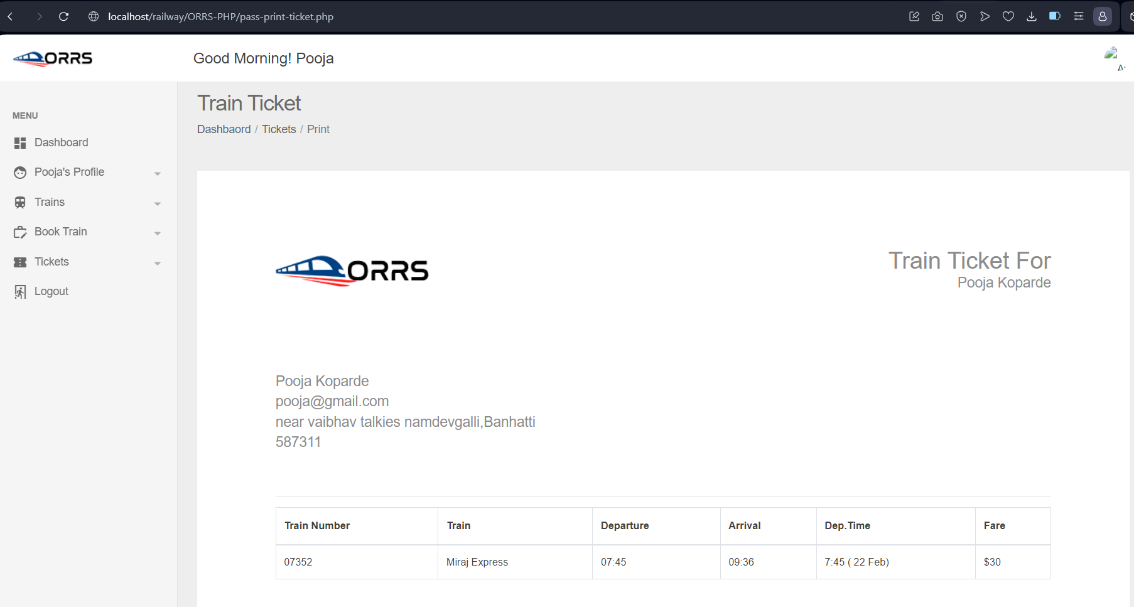
EXPECTED OUTCOME

Slide 10
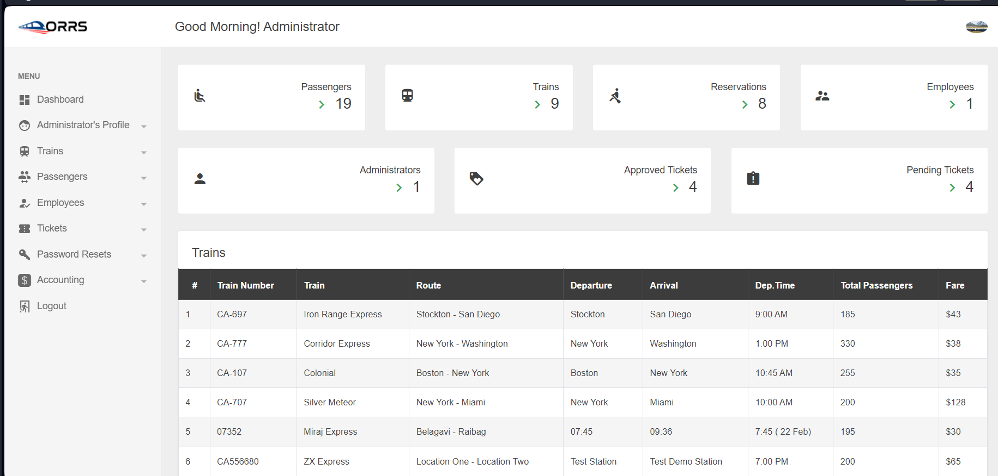

Slide 11
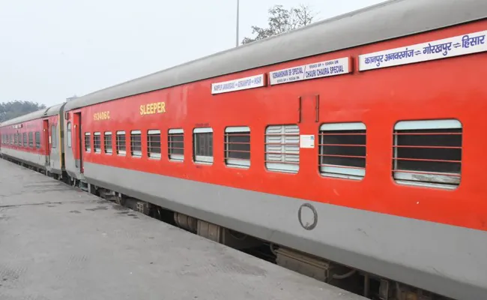
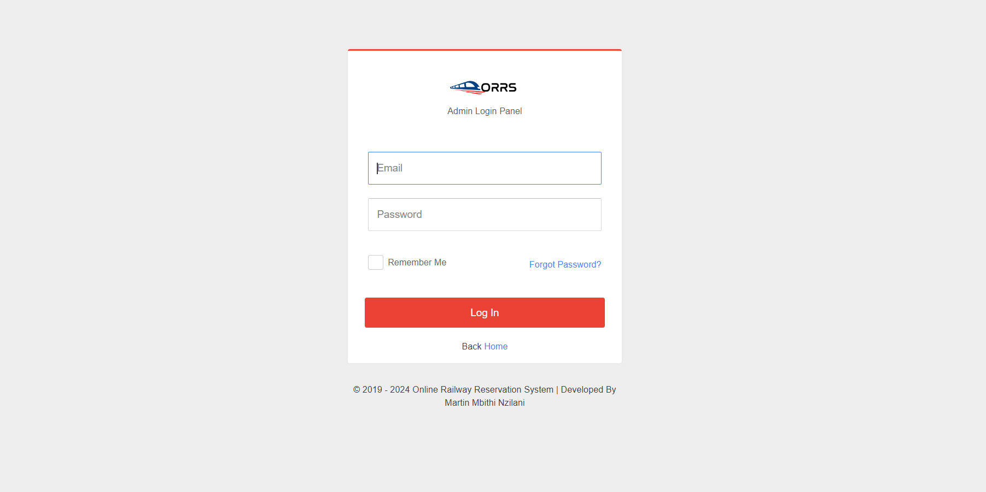

Slide 12
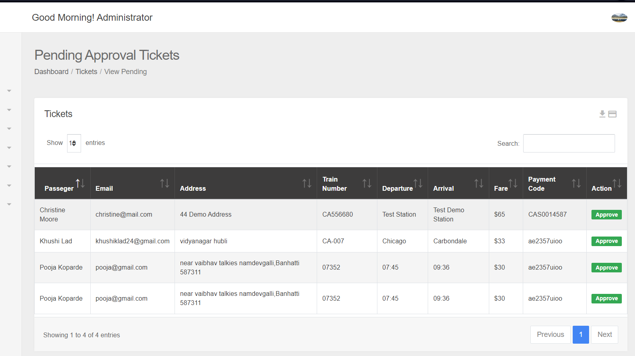

Slide 13
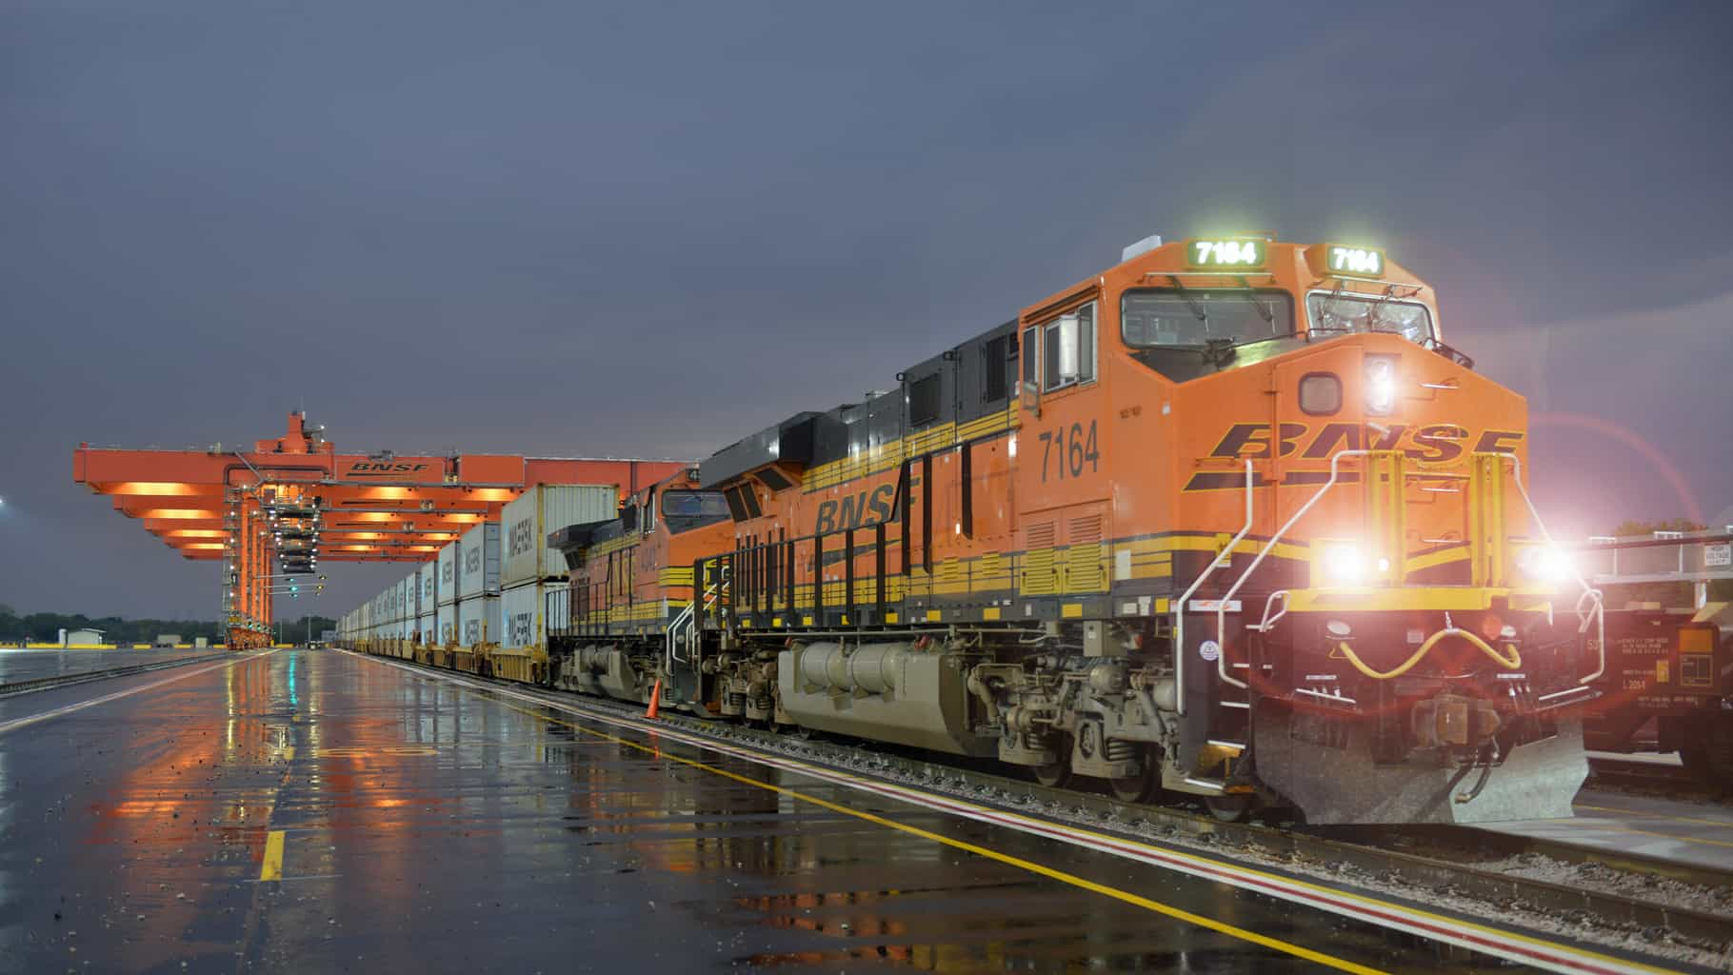
THANK YOU

